Slide 1


Turbo Machines
Basics of Turbo machines
Atul M.Elgandelwar, Associate Professor,
School of Mechanical Engineering

Slide 2
Basics of Turbo machines
Part (A)
Introduction : Definition ,Classification , Fundamental equations, Comparison with positive displacement machines, Applications of turbo machines
Part (B)
Impact jet : Laws of Impulse momentum and it’s application ,Force exerted on fixed and moving flat plate , curved vanes , series of flat plates and radial vanes, velocity triangles and their analysis, work done and efficiency.

Slide 3
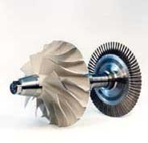
Introduction to Turbo Machines
Compressor rotor (imparts energy to the fluid)
A turbomachine is basically a rotating machine.
The rotating wheel is called a rotor / runner / impeller.
The rotor will be immersed in a fluid continuum
The fluid medium can be gas / steam / water / air
Energy transfer takes place either
Turbine rotor (extracts energy from the fluid)
from rotor to fluid, or
from fluid to rotor

Slide 4
Introduction to Turbo Machines
Definition
A turbo machine is a device in which there is continuous transfer of energy between a rotating member and a flowing fluid, due to dynamic action resulting in the change in the pressure and /or the momentum of the fluid.
The word Turbo implies that which spins or whirls around.
Example : Turbines, compressors, pumps, fans etc.

Slide 5
Turbo or turbinis is of Latin origin and it implies that which spins or whirls around.
A turbomachine is a rotary machine.
Which always involves an energy transfer between a continuously flowing fluid and a rotor
It is a power or head generating machine
It uses the dynamic action of the rotor or impeller or runner which changes the energy level of the continuously flowing fluid through the rotor.

Slide 6
Features of turbo machines
There is basically a shaft mounted on bearings.
The “vaned rotor” is keyed onto the shaft.
“Rotor” is a general name :
  Rotor is known as runner in work-producing turbo machines or turbines.
  Rotor is known as impeller in the work-absorbing turbo machines, pumps or compressors
  Shaft is coupled to either a generator ( to produce power) or a motor (to utilize power)
  A stator encloses the rotor, it guides the flow of fluid also it houses components such as guide vanes, nozzles, or diffusers.

Slide 7
Turbo machine is device that exchange energy with fluid using continuously flowing fluid and rotating blade.
Eg. Aircraft engine & Wind turbine.
Turbine - A device extract energy from the fluid.
Compressor, fan, blower or pump- - The device deliver energy to fluid.
Depending on the fluid used and magnitude of the change in pressure .

Slide 8
Turbo machine – It is a device in which energy transfer occurs between fluid and rotating element , due to dynamic action & result in to change in pressure and the momentum of the fluid.
Pump- It is hydraulic machine which convert the mechanical energy in to hydraulic energy.
Hydraulic energy is in the form of pressure energy . Increase in the pressure energy or kinetic energy or both pressure and kinetic energy of fluid by converting the mechanical energy.
Compressor – A device or machine providing air at high pressure .
Receiver – An air compressor takes in air at atmospheric pressure , compresses it and delivers the high pressure air to a storage vessel.

Slide 9
Fan –The primary function of fan is to circulate the air or gases in required quantity and at required places in the power plant by maintaining pressure difference.
Blower- Displacement air compressor in which air is trapped between two mutually engaging surfaces.
The squeezing action takes place on the trapped air.( also called as Low pressure turbo compressor)

Slide 10
Classification of turbo machines.
1. Based on direction of Energy flow in the machine.
Energy is given by fluid to the rotor -(working medium-water) - Power generating turbo machine E.g. Turbines
Energy given by the rotor to the fluid -(working medium-air/gas/vapour) - Power absorbing turbo machine E.g. Pumps, blowers and compressors.
2. Based on type of fluid used in the machine.
Hydro turbo machines –Pumps, water turbine
Thermal turbo machines- Compressors, fan, blower

Slide 11
3. Based on direction of fluid flow in the machines
Axial flow – Axial pump/compressor or Kaplan turbine
Mixed flow – Mixed flow pump, Francis turbine
Radial flow – Centrifugal pump or compressor
Tangential flow – Pelton wheel turbine.
4. Based on dynamic action of fluid in turbo machine
Impulse type (constant pressure) E.g. Pelton turbine
Reaction type (variable pressure) E.g. Francis reaction turbines
5. Based on position of rotating shaft
Horizontal shaft – Steam turbines
Vertical shaft – Kaplan water turbines
Inclined shaft – Modern bulb micro

Slide 12
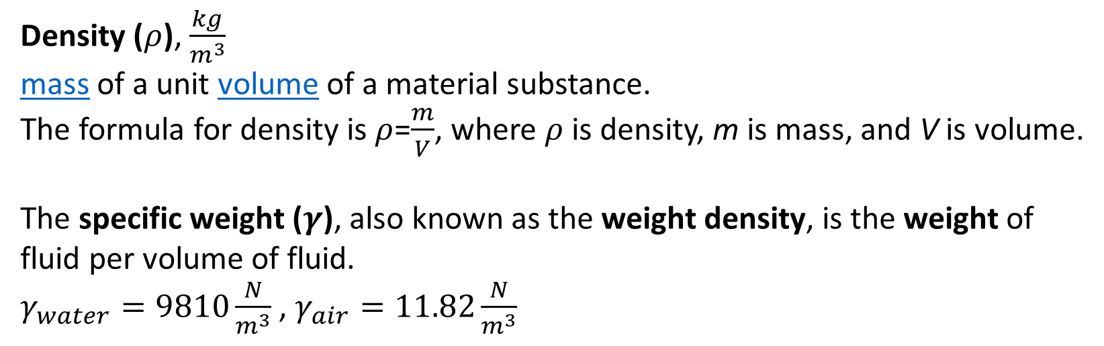
Fundamental Equations
Density ($ρ$), $\frac{kg}{m^{3}}$
mass of a unit volume of a material substance.
The formula for density is $ρ$=$\frac{m}{V}$, where $ρ$ is density, m is mass, and V is volume.
The specific weight ($γ$), also known as the weight density, is the weight of fluid per volume of fluid.
$γ_{water}=9810\frac{N}{m^{3}}$ , $γ_{air}=11.82\frac{N}{m^{3}}$

Slide 13
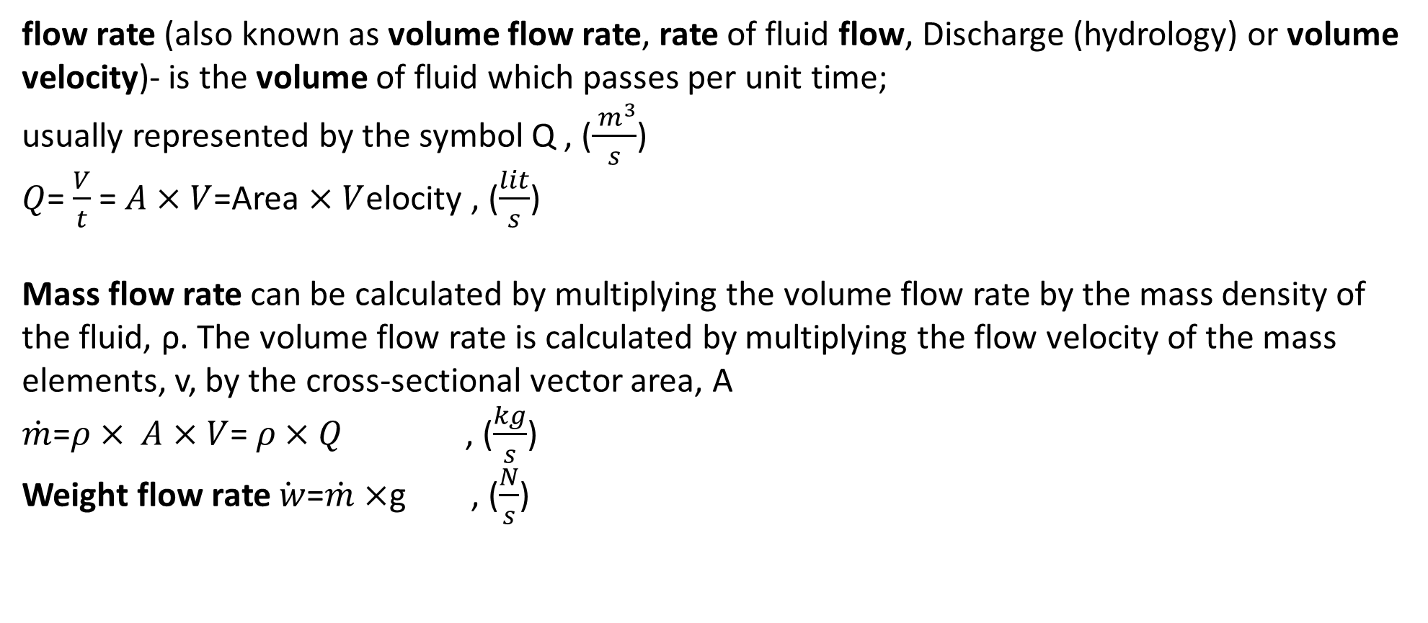
Fundamental Equations
flow rate (also known as volume flow rate, rate of fluid flow, Discharge (hydrology) or volume velocity)- is the volume of fluid which passes per unit time;
usually represented by the symbol Q , ($\frac{{ m}^{3}}{s}$)
$Q$= $\frac{V}{t}$ =$A×V$=Area $×V$elocity , ($\frac{lit}{s}$)
Mass flow rate can be calculated by multiplying the volume flow rate by the mass density of the fluid, ρ. The volume flow rate is calculated by multiplying the flow velocity of the mass elements, v, by the cross-sectional vector area, A
$\dot{m}$=$ρ× A×V$= $ρ×Q$ , ($\frac{kg}{s}$)
Weight flow rate$\dot{ w}$=$\dot{m}$ $×$g , ($\frac{N}{s}$)

Slide 14

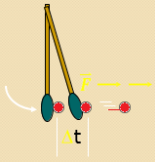
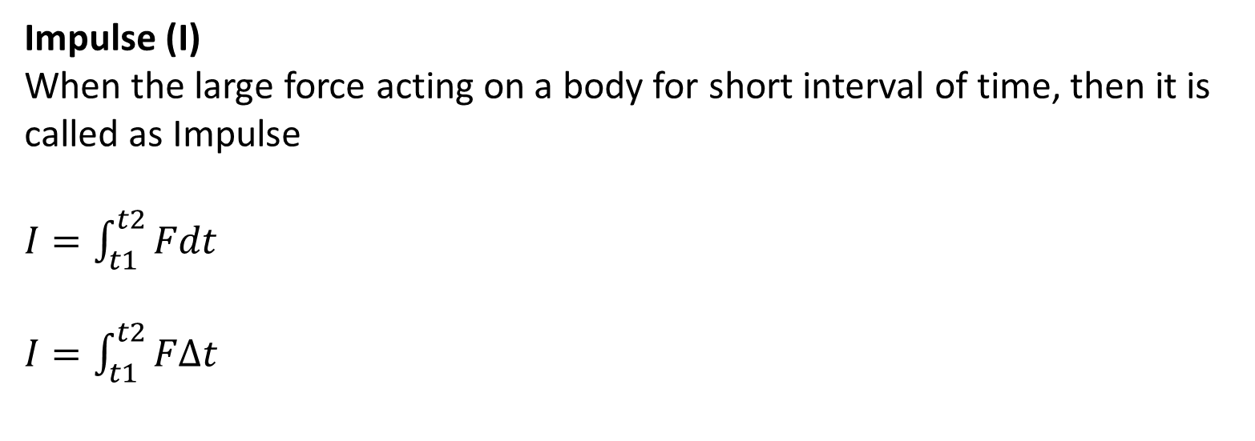
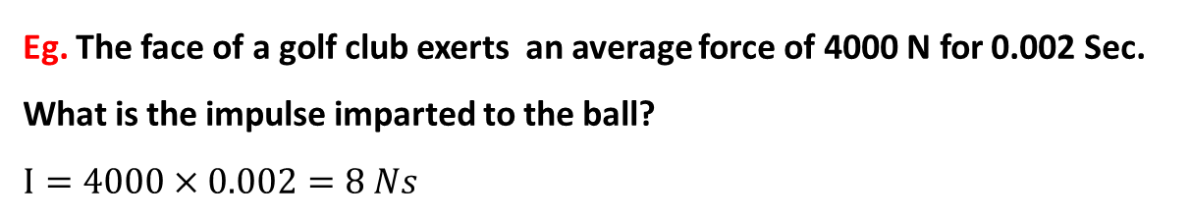
Fundamental Equations
Impulse (I)
When the large force acting on a body for short interval of time, then it is called as Impulse
$I=\int_{t1}^{t2}{Fdt}$
$I=\int_{t1}^{t2}{FΔt}$
Eg. The face of a golf club exerts an average force of 4000 N for 0.002 Sec. What is the impulse imparted to the ball?
$$I=4000×0.002=8 Ns$$

Slide 15


Fundamental Equations
Momentum (M)
Momentum is defined as the product of mass and velocity.
(vector quantity)
Units: kg m/s; g cm/s; slug ft/s
Momentum=M=m$×$V
$M=m×V=1000×16=16000 Kg−m/$s
m = 1000 kg, v= 16 m/s

Slide 16
Law of Impulse Momentum Principle
The fundamental principle of dynamics is the Newton’s Second Law of Motion, which states that,
  “The rate of change of momentum is directly proportional to the applied force and takes place in the direction of the force”.
According to Impulse-momentum principle:
  “State of rest or of uniform motion of a body changes in the direction of an externally applied force, and that the magnitude of the force equals the rate of change of momentum”.

Slide 17


Momentum is the product of mass and velocity of the body, this vector quantity has direction as well as magnitude and
it represents energy of motion stored in a moving body
For a constant mass flow rate, the momentum equation
Dynamic force applied in x- direction = rate of change in momentum in x- direction

Slide 18
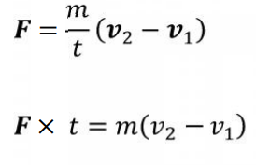


(F x t) is called the Impulse of the applied force
the resulting change in momentum
Impluse $=∆ momentum$
The above equation represents, the force exerted by the body on the fluid.

Slide 19
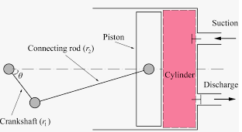
Comparison with Positive displacement machines
Positive displacement machines
In these machines the fluid is directed into a closed volume.
Energy transfer to the fluid is accomplished by movement of the boundary of the closed volume
causing the volume to expand or contract .
Example: Reciprocating compressor, screw pump, gear pump etc.
Heart is a good example of positive displacement pump.
Water meter is example of positive displacement turbine.
Reciprocating compressor

Slide 20
Comparison with Positive displacement machines
Action
Positive displacement machines creates thermodynamic and mechanical action between a near-static fluid and relatively slow moving surface, causing change in volume or displacement of the fluid.
Turbo machines creates thermodynamic and dynamic action between a flowing fluid and a rotating element and involves energy transfer with pressure and momentum changes.
Operation
Positive displacement machines generally involves a reciprocating motion and unsteady fluid flow. Example of positive displacement machines with rotating motion are gear pump and screw pump.
Turbo machines involves steady flow of fluid and pure rotary motion of mechanical element.

Slide 21
Sr. No. | Aspects | Positive displacement machines | Turbomachines
1 | Action | Involves thermodynamic and mechanical action between nearly static fluid and slow moving surface, volume change causes pressure change | Involves thermodynamic and dynamic action between a continuously flowing fluid and a rotating element. The pressure change occurs primarily by means of dynamic action of a rotating element.
2 | Operation | Involves reciprocating motion, unsteady flow of fluid, fixed amount of fluid being positively contained during its passage through the machine, stopping of the machine during operation traps a certain amount of fluid whose state is different from that of the surroundings | Involves rotary motion with nearly steady flow. Stopping of the machine will let the fluid state change rapidly and become same as that of the surroundings.

Slide 22
Sr. No. | Aspects | Positive displacement machines | Turbomachines
3 | Mechanical features | Employs low speed, complex in mechanical design, heavy per unit output, valves are present, vibration problems, heavy foundations required. | High speed machines, simple in design, light weight, no valves, vibration not severe, light foundation required.
4 | Efficiency of energy conversion | Efficiency of energy conversion during both expansion and compression is high. | Low.
5 | Volumetric efficiency | Low | High, Nearly 100%.
6 | Fluid phase change and surging | Relatively minor importance in these machines. | Cavitation, surging cause serious difficulties to smooth operation.

Slide 23
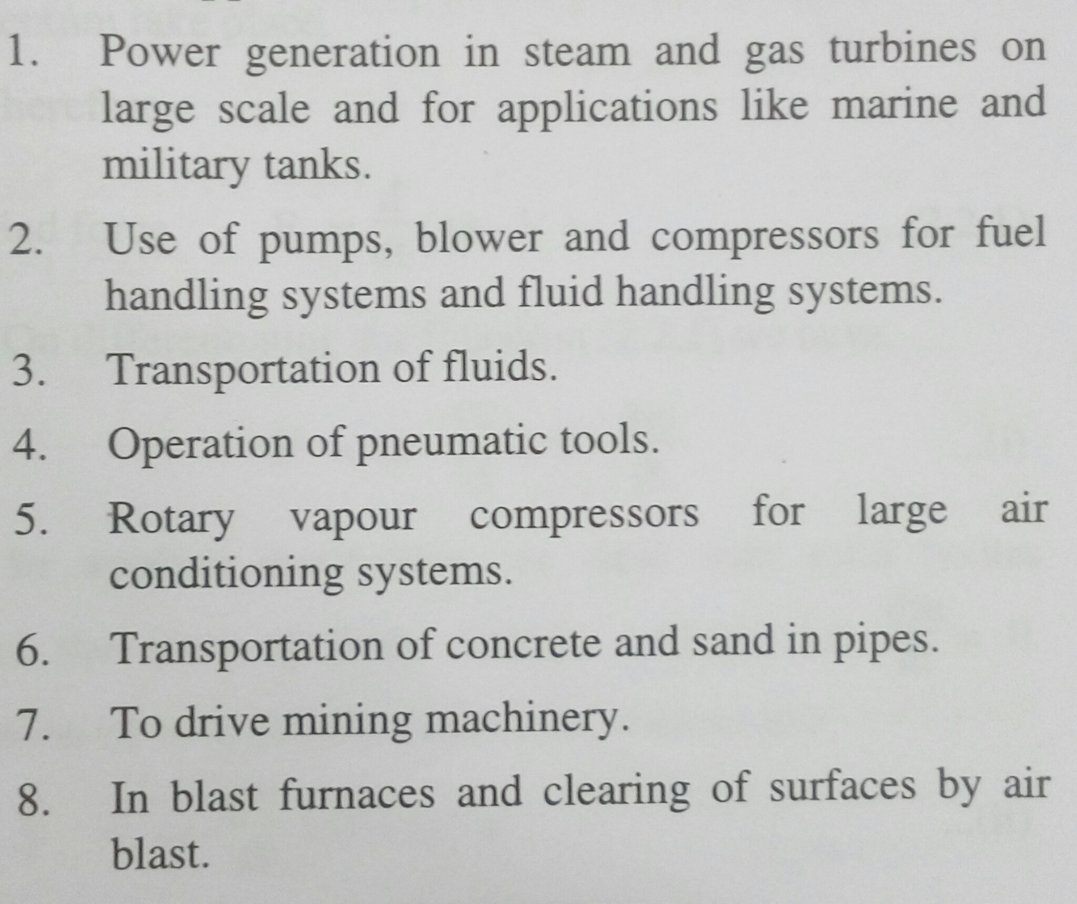
Applications of Turbo machines

Slide 24
Thank You..!
Any Questions ???

